Slide 1
Welcome to Instruction Retreat 2018!
Help yourself to breakfast & coffee

Slide 2
Roles for Teaching Librarians
Approved by the ACRL Board of Directors, April 2017

Slide 3
GOALS FOR THE RETREAT
Today, we begin to recharge our instruction program by
better understanding who we are as individual instruction librarians,
learning more about our fellow librarians and how we can best communicate with each other,
setting goals for the following year, and
examining our learning outcomes to best align them to our goals and the mission of Tulane, as well as to assess our instruction.

Slide 4
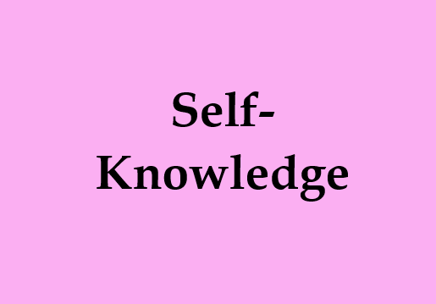
Values Pyramid
VALUES & MOTIVATION

Slide 5
Values Pyramid
COMMUNICATION STYLE INVENTORY
Merrill & Reid Social Style Model

Slide 6
Values Pyramid
COMMUNICATION STYLE INVENTORY

Slide 7
Values Pyramid
LET’S PLOT SOME GOALS!
End of Summer
End of Fall
End of Spring

Slide 8
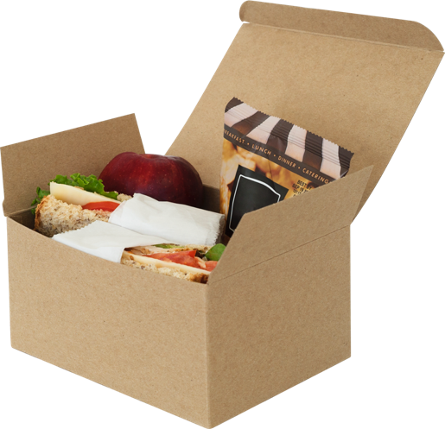
Lunch!

Slide 9
Values Pyramid
LEARNING OUTCOMES
Pile 1
Pile 2
Pile 3
What learning outcomes have you recently used with your instruction?
What learning outcomes are you planning to use (but haven’t used recently)?
What learning outcomes are you not using or planning on using in the near future?

Slide 10
Values Pyramid
LEARNING OUTCOMES

Slide 11
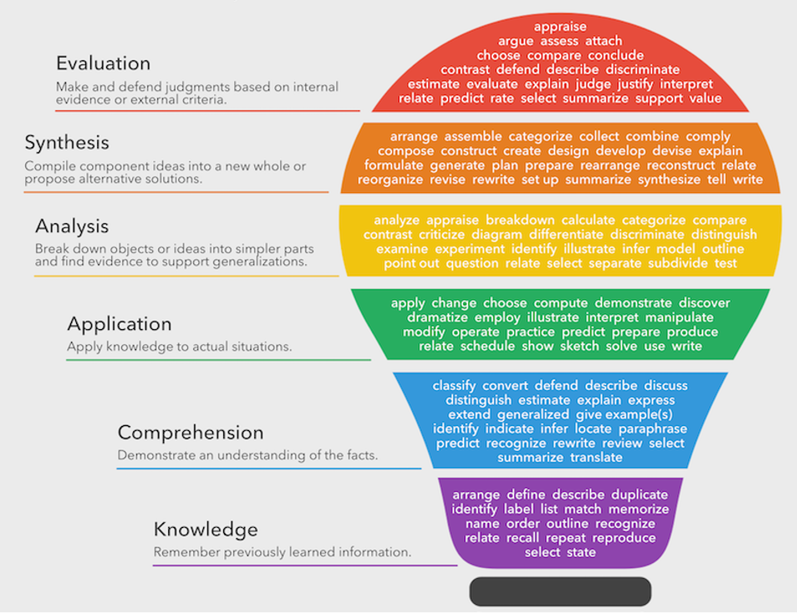
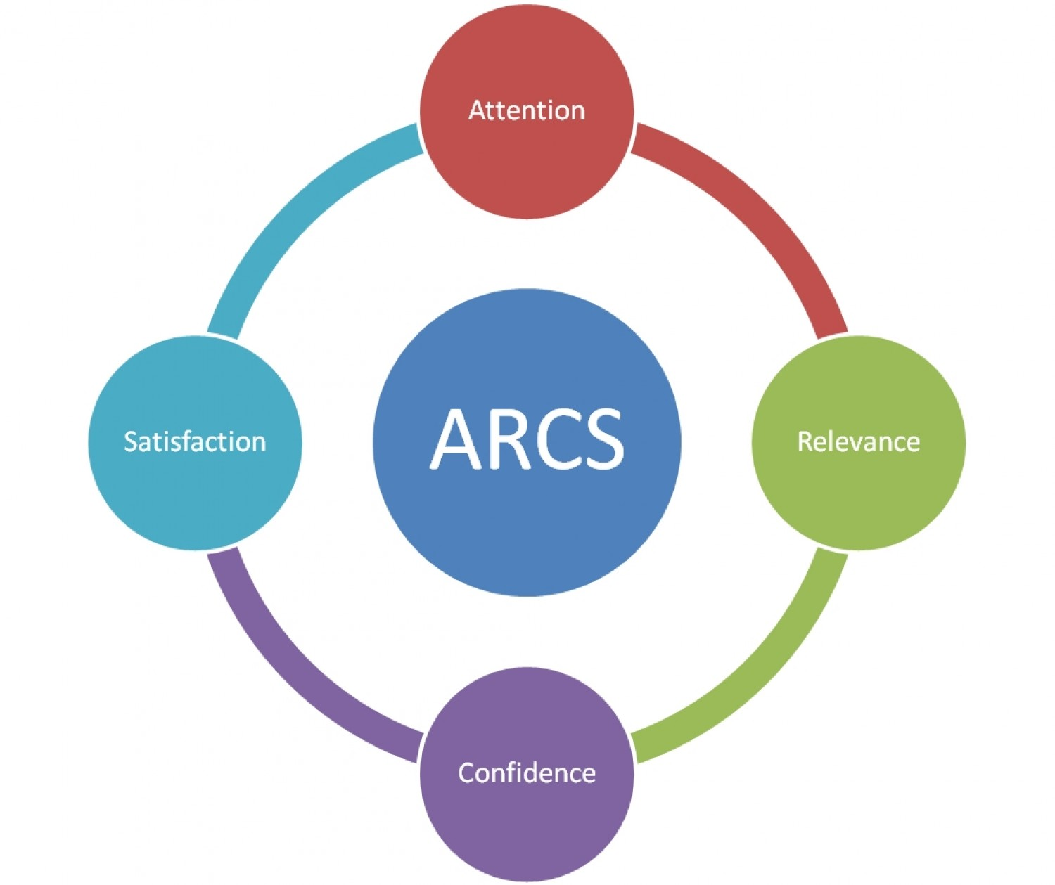
Values Pyramid
LEARNING OUTCOMES

Slide 12
Values Pyramid
What’s Next?

Slide 13
Values Pyramid

